Slide 1
Introduction to Godot

Slide 2
Content of session
01
02
03
04
Godot Now
Nodes & Scenes
Scene tree
Input

Slide 3
01
Godot Now

Slide 4
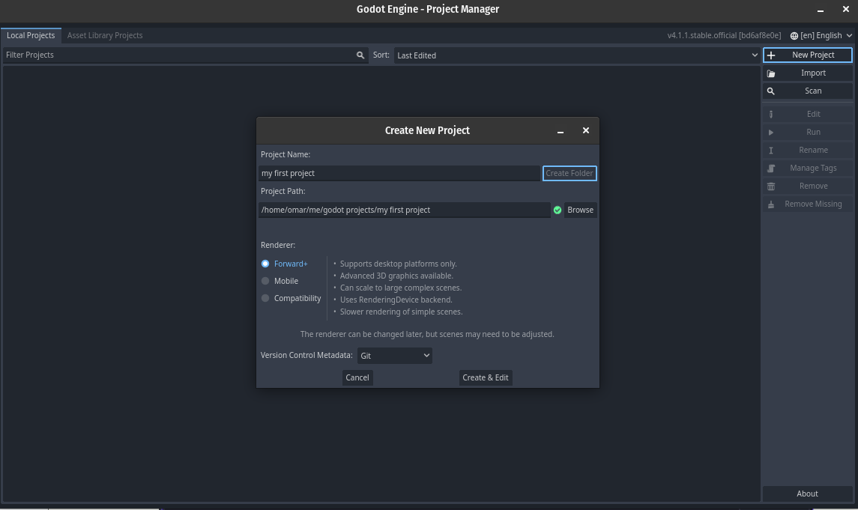
Quick look inside Godot Now

Slide 5
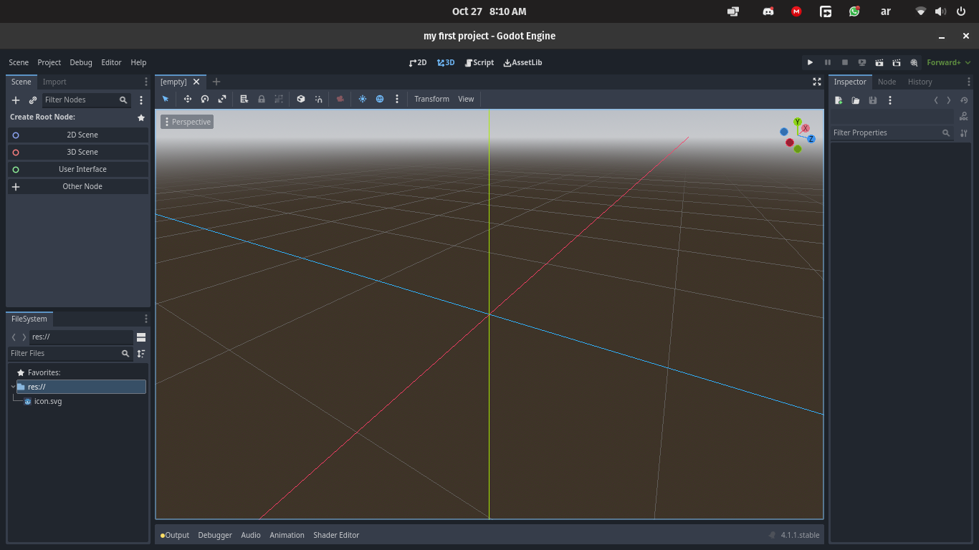
Quick look inside Godot Now

Slide 6
02
Nodes & Scenes

Slide 7

Nodes & Scenes
Nodes
It’s the smallest unit in the game engine hierarchy, and every node has its own properties and functionalities.
Scenes
Scenes are a collection of nodes, and their different functionalities and attributes come together and produce a more complete result.

Slide 8
Nodes
You can think of the them like Legos You can use it in different kind of objects like an image, sound, physics bodies, or camera.
Put them together and you can make a car, a character or any thing you need.

Slide 9
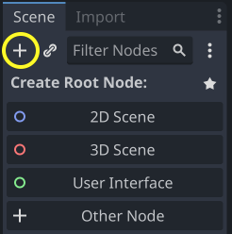
Nodes
You can use node by adding them in your current scene.
To add nodes, you must click on the plus button or click in ctrl + a on your keyboard

Slide 10
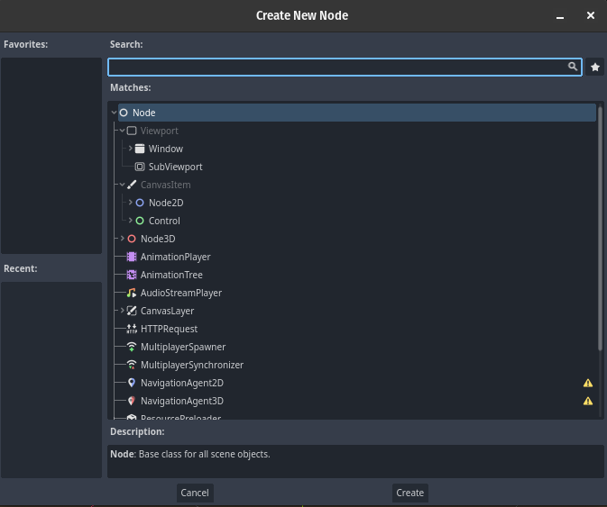
Nodes
Godot will pop up this window to you. In this window you will choice the type of node you want to use

Slide 11
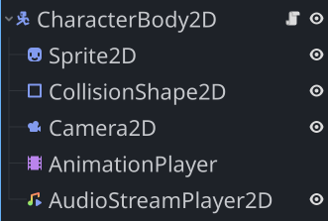
Scenes
It’s a group of nodes, enabling you to construct complex objects out of node “building blocks”, this is a powerful tool.

Slide 12
03
Scene tree

Slide 13
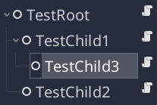
Scene tree

Slide 14
Scene tree
extends Node
func _init():
# Note: a Node doesn't have a "name" yet here.
print("TestRoot init")
func _enter_tree():
print(name + " enter tree")
func _ready():
print(name + " ready")
# This ensures we only print *once* in process().
var test = true
func _process(delta):
if test:
print(name + " process")
test = false
_init() is called when the object is first created. It now exists in the computer’s memory.
_enter_tree() is called when the node first enters the tree. This can be when instancing or when add_child() is used, for example.
_ready() is called when the node and its children have all been added to the tree and are ready.
_process() is called every frame (typically 60 times per second) on every node in the tree.

Slide 15
Let’s try Making a Playable Character!

Slide 16
04
Inputs

Slide 17
Inputs
What’s Inputs ?
Player input is what allows a player to interact with the game and world, from keyboard inputs, mouse clicks and movement, to joystick controls.

Slide 18
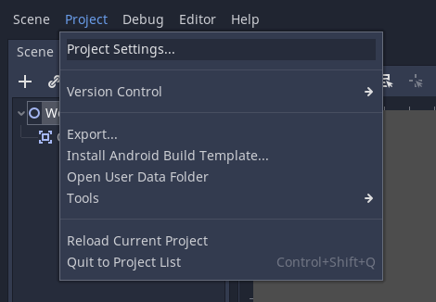
Inputs
You can define inputs by clicking on Project → Project Settings → Input Map. There you can add a new Action and give it one or multiple inputs including keyboard (key and physical key) inputs, joystick button and axis inputs, and mouse inputs.

Slide 19
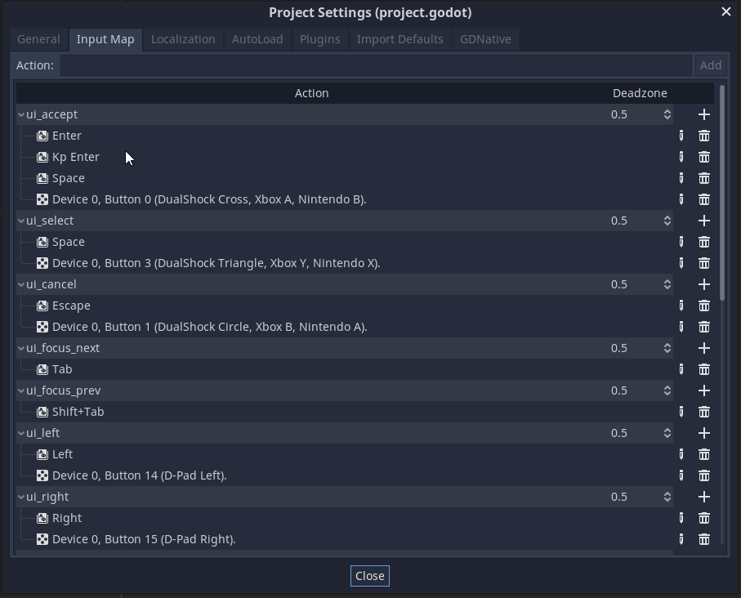
Inputs

Slide 20
Inputs
Using our Defined Inputs
In GDScript we have the Input class, which helps us handle inputs. Some useful methods are:
Input.is_action_pressed()
Input.is_action_just_pressed()
Input.is_action_just_released()
And there are more methods for more specific Input handling!

Slide 21
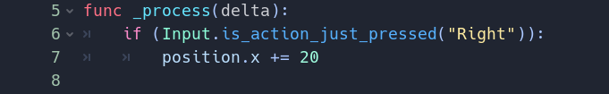
Inputs
We can pass to these function our inputs we’ve previously defined as such
Input.is_action_pressed(“move_right”)
and it will return a boolean value that we can use in our script
It is important to note that the input checking must be in the _proccess() method so we’re always checking for player input.

Slide 22
Thanks!
Any Questions

